Slide 1
living stories
object management in the home
Cynthia Liang, Chloe Barreau, Amy Xu, Jenny Zhi
Notes:
DEAD OBJS, LIVING STORIES

Slide 2
overview
i. needfinding methodology
ii. interview results
iii. analysis
iv. insights
v. summary
vi. questions

Slide 3
overview
i. needfinding methodology
ii. interview results
iii. analysis
iv. insights
v. summary
vi. questions

Slide 4
needfinding methodology

Slide 5
a couple questions
What’s your current living environment? (ex. House, apartment, dorm? Suburb, city, college campus? Alone or with others?)
Growing up, did you move or stay in one place?
Growing up, were you an only child or did you have siblings?
How did your social/living situation change after you moved out/graduated/moved to a new place?
Who are the people you talk to or see most often?
What makes you happy at home? What about your living space makes you happy? Why?
Tell me about a time you felt lonely at home.

Slide 6
interviewees
What we wanted
- diversity of background
- diversity of living area
- diversity of living mates
How we achieved this
- diversity of interview location and targeting

Slide 7
overview
i. needfinding methodology
ii. interview results
iii. analysis
iv. insights
v. summary
vi. questions

Slide 8
interview results

Slide 9
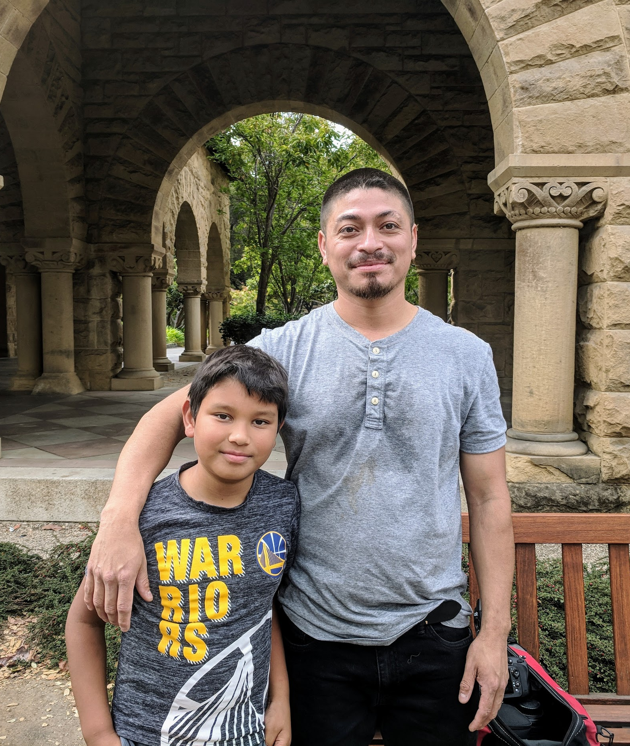
“I cleared out everything, sold stuff I never used, and used the space to relax.”
Diego
Cook manager, freelance photographer
House, Oakland, CA

Slide 10

“[I hold] mostly small gatherings in the home, but inviting people is troublesome.”
Michael
Chip designer
House, Fremont, CA

Slide 11

“I think I just really like how we're comfortable enough to just, like, spend most of our time at home in the living room either watching TV or talking or vegetating.”
Jason
Software Engineer, Amazon
Shared house, Santa Clara, CA
Notes:
Comfort of who is in the space
Other options:
I think I just really like how we're comfortable enough to just like spend most of our time at home in the living room either watching tv or talking or vegetating.
It's good that we have a pretty large common area. The fact that we have a tv in our living room helps a lot too.

Slide 12
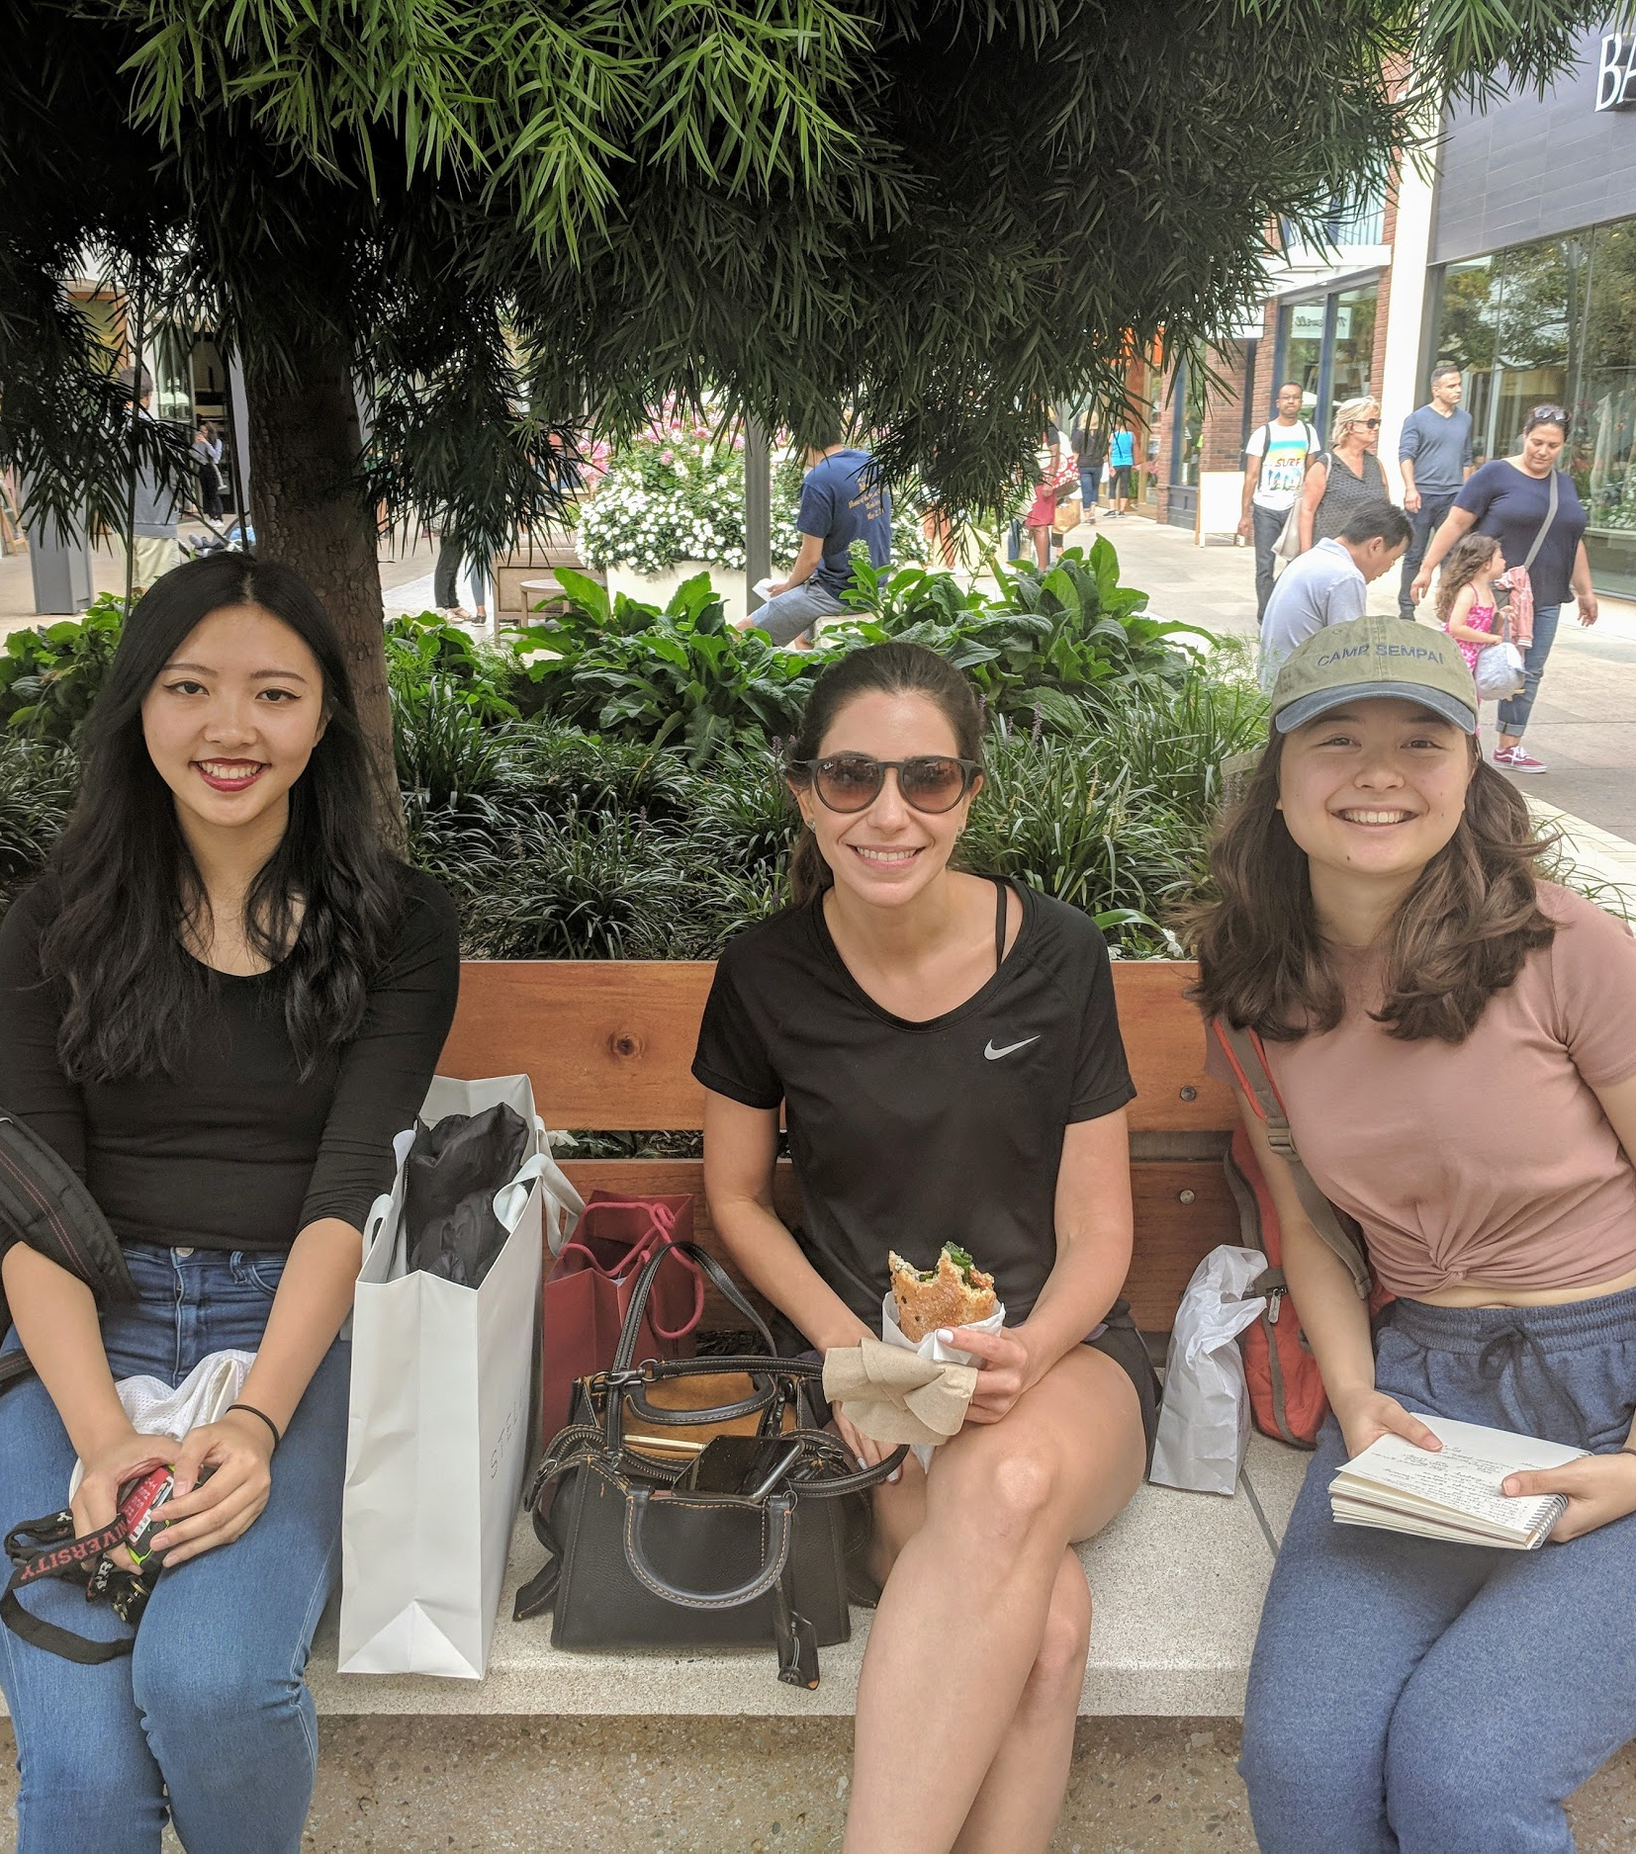
“I always try to plant something. I was always crazy about that place that my mother-in-law and grandmother had.”
Fernanda
Lawyer, mother
Large duplex, San Paulo, Brazil

Slide 13
“That belonged to my grandmother. That’s what she used to do laundry in. I cleaned it up a bit.”
Professor Snipp
Murray Resident Fellow, Sociology Prof.
Large RF House, Stanford, CA

Slide 14
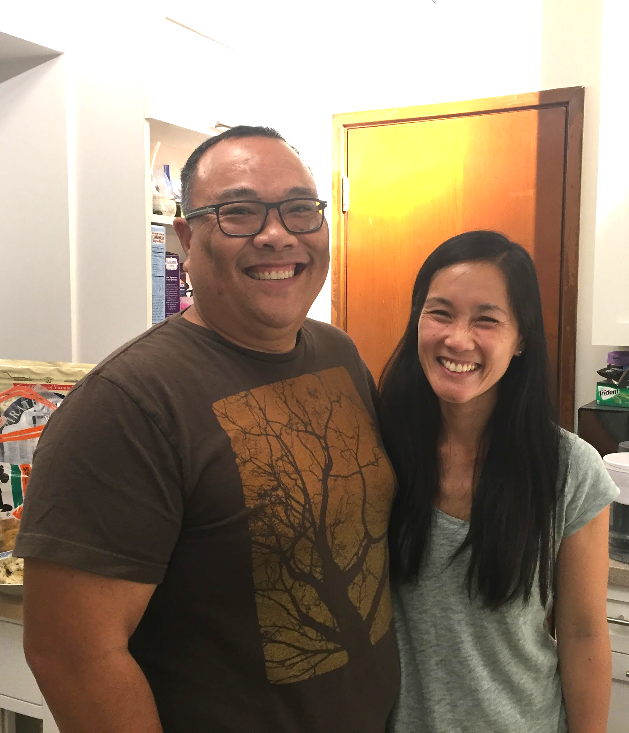
“We’re not tied to anything; I think a sense of what home is is the people.”
Edith and John
Okada Resident Fellows
Small RF House, Stanford, CA

Slide 15
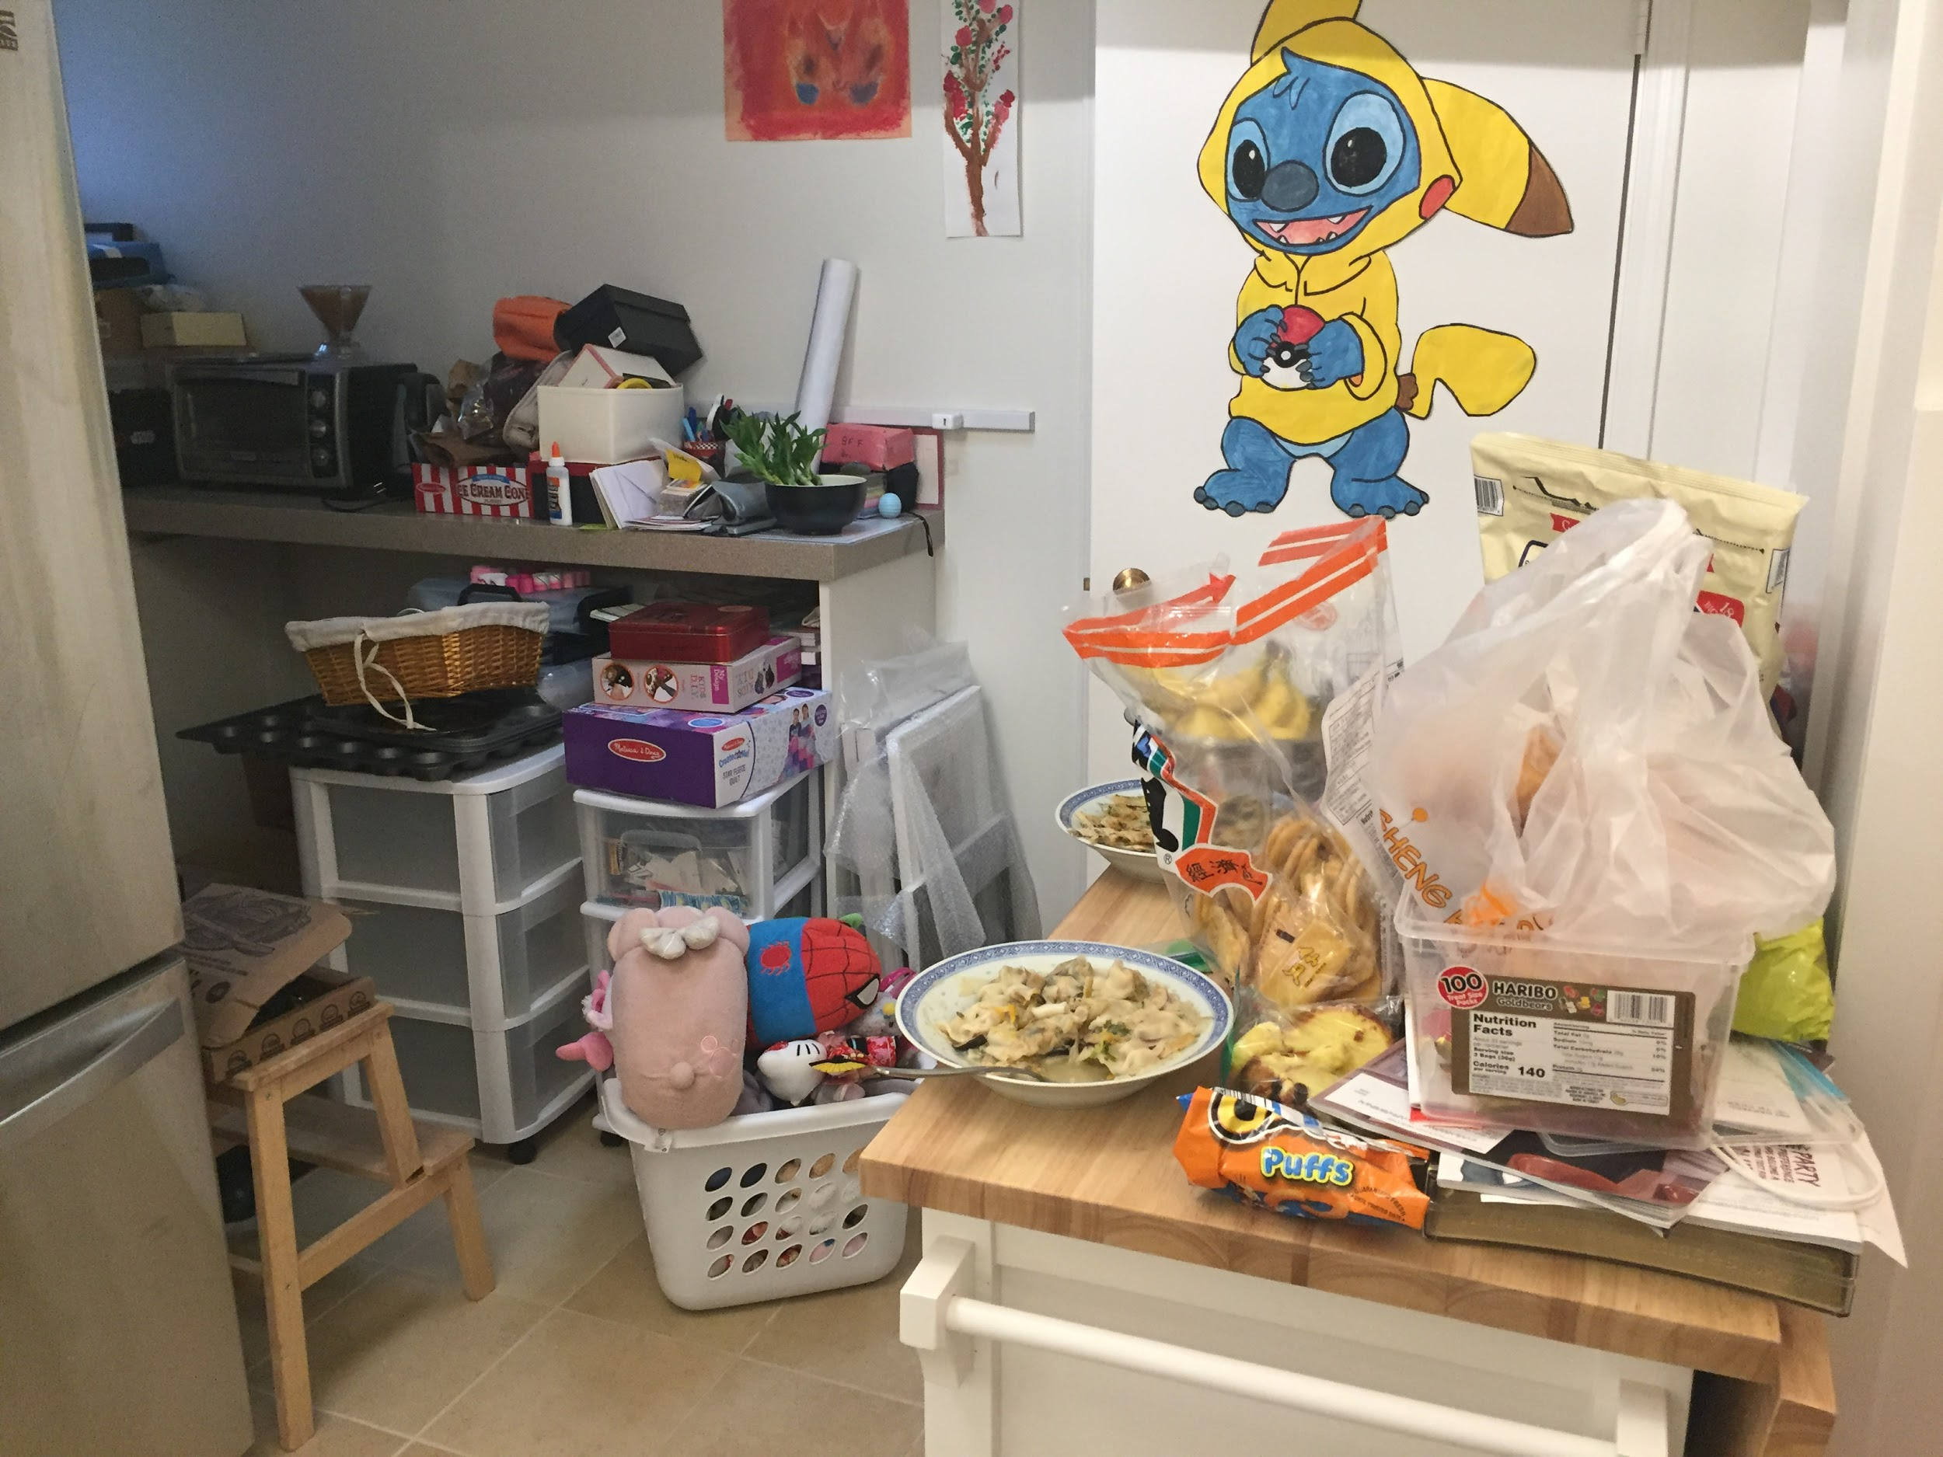
What?
How?
Why?
Edith and John
Okada Resident Fellows
Small RF House, Stanford, CA

Slide 16
overview
i. needfinding methodology
ii. interview results
iii. analysis
iv. insights
v. summary
vi. questions

Slide 17
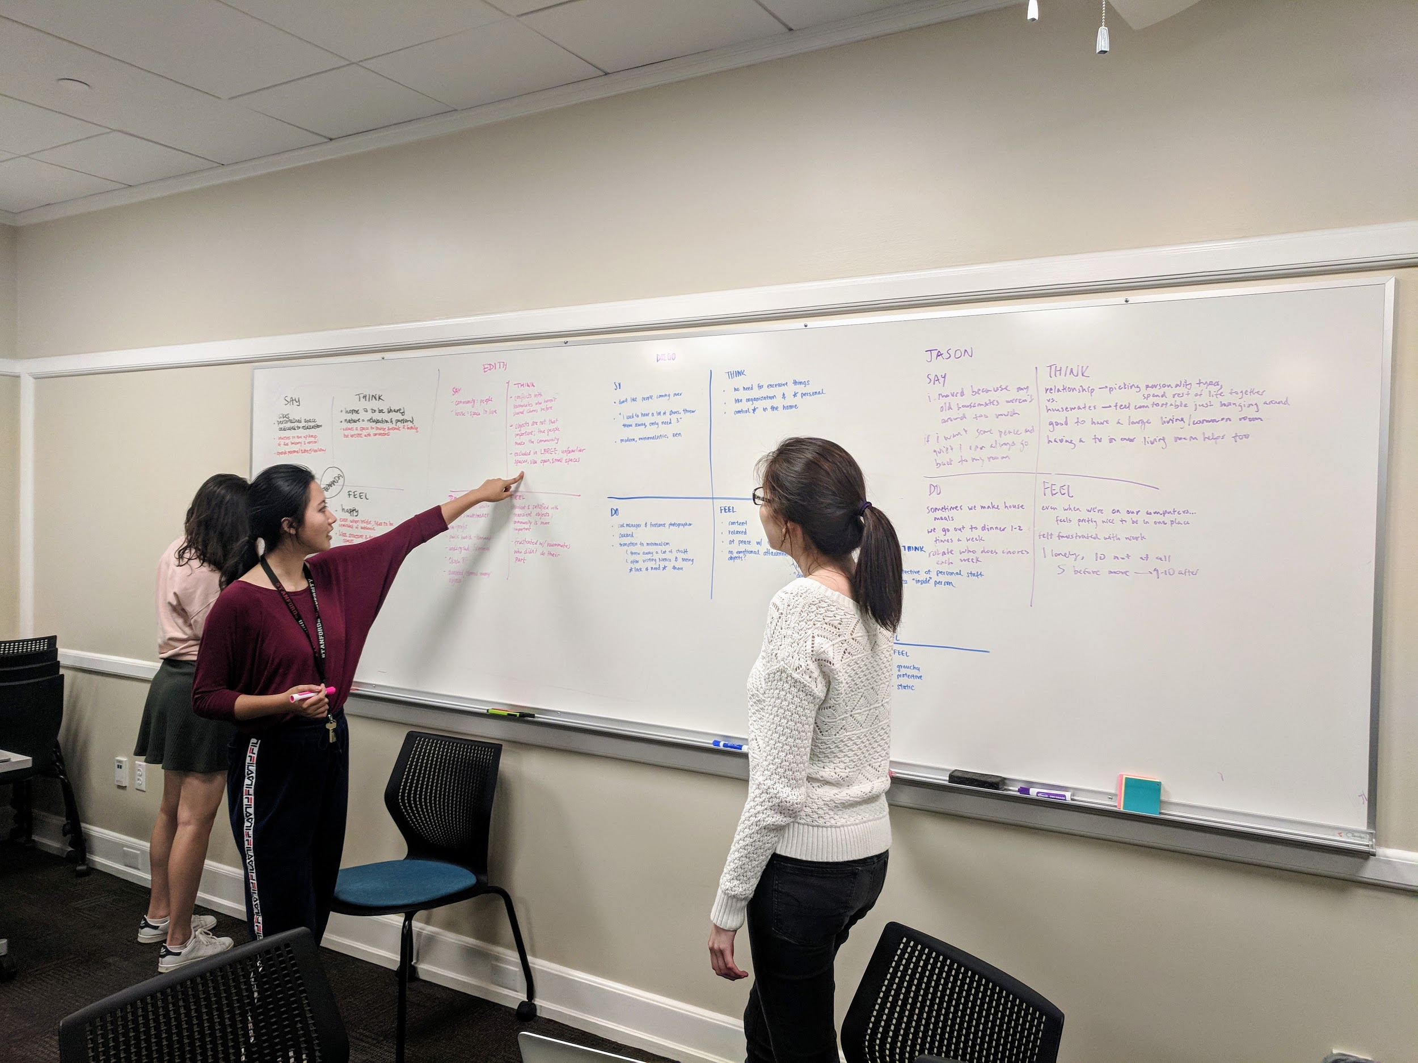
analysis

Slide 18
SAY
THINK
DO
FEEL

Slide 19
“[I hold] mostly small gatherings in the home, but inviting people is troublesome.”
“What’s bad is that we get used to not fully unpacking.”
SAY
“That belonged to my grandmother. That’s what she used to do laundry in. I cleaned it up a bit.”
“Nobody paid attention to whether I was there or not . . . I don’t think I felt a strong sense of community in my residence.”
“I always try to plant something. I was always crazy about that place that my mother-in-law and grandmother had.”
“I think a sense of what home is is the people.”
“I don’t have people over very often.”
“I think [lack of responsibility from dormmates] showed who had been involved in household duties.”
“I can have a schedule; my space turns into an office. At night, I stop everything, and it becomes my living area. Everything goes away.”
“I cleared out everything, sold stuff I never used, and used the space to relax.”
“When we moved back here, [husband] went back to the storage room, pulled out the sofa, and gave it to [member of community].”
Notes:
“we’re not tied to anything; I think a sense of what home is is the people, because we’ve been moving around so much. There isn’t anything that has to be a certain way. I think some people are really tied to their [belongings]”
“What’s bad is that we get used to not fully unpacking”
“There’s all this stuff we haven’t touched since we moved; it’s just sitting there”
“Dorm is alone space”
“I don’t like people coming to my house”
“I can have a schedule, my space turns into an office. At night, I stop everything, and it becomes my living area. Everything goes away.”
“I don’t have people over very often”
“I don’t think the kids go to friends’ houses anymore. I think it has changed a lot. They graduated onto the little screens”
“That belonged to my grandmother. That’s what she used to do laundry in. I cleaned it up a little bit”
“Most of the time the story is told”
“I enjoyed my sophomore dorm a lot better. It was smaller . . . I liked how the upperclassmen were there to build community . . . it was a very open community”
“[Former dorm] was so big . . . that nobody noticed if I didn’t participate in things. Nobody paid attention to whether I was there or not . . . I don’t think I felt a strong sense of community in my residence.”
“When we moved back here, [husband] went back to the storage room, pulled out the sofa, and gave it to [member of community]. By that point, it was a small [gesture]; it had been a part of our apartment furniture”
“I think [lack of responsibility from dormmates] showed who had been involved in household duties.”
“For a long time, we didn’t have a place to put things”
“[The kids’] bed is just a place to sleep; that’s not where they spend most of their time. We see the dorm, and by extension the campus, as our community”
“We have to be out by 7:35, it’s like military drill”

Slide 20
SAY
THINK
DO
FEEL

Slide 21
Pets his cat while responding to questions. The cat softens his tone and gives him opportunities to make jokes.
Looks away while thinking about memories
didn’t touch others’ objects, ask not to be photographed
is concerned about how she looks in the photograph
shows us stored objects that are not needed at the moment
Keeps emotional important objects (stories)
Washes dishes and moves around kitchen purposefully cleaning up from a dorm lunch
Asks only to be photographed if we were in the picture with her
Pauses multitasking when talking about things he enjoyed
Very carefully packs photography bag while talking to us
DO
Asks to keep interview short
eats while talking
Gets excited when talking about self-designed home refurbishments
Notes:
Keep emotional important objects (stories)
Keep practically useful things
Don’t touch others’ objects
Transition to minimalism, cleared everything sold stuff never used, used space to relax
donate/store objects
Invite guests -- parts of home become private, inaccessible to guests
Spend time in spaces in which personal time and effort was invested
Mostly only small gatherings in the home, rare in the house
Multitasking--washing dishes and moving around kitchen cleaning up from a dorm lunch
Pets his cat while responding to questions. The cat softens his tone and gives him opportunities to make jokes.
Eats while responding, and is concerned about how she looks in the photograph (food in teeth)
asked us if we could do a shorter interview

Slide 22
SAY
THINK
DO
FEEL

Slide 23
Needs organization and personal control in home
Keeps and values practically useful things
THINK
Moving is not too much trouble, working around day-to-day is more important
Home is to be shared
Objects themselves are not that important; people make community
Values space to invite friends and family
Spends time in spaces in which personal time and effort was invested
Public place & personal place are separate, didn’t touch others’ objects and asked not to be photographed
It’s valuable to take care of items that are personal
No need for excessive objects, objects viewed as transient
Notes:
Don’t see clutter = acceptable
Visible clutter = no relaxation
No need for excessive objects, viewed as transient
Need organization and *personal control* in the home
Objects are not that important; people make community
Excluded in large unfamiliar spaces, like open, small spaces
Home is to be shared
Values space to invite friends and family
Wrestle with convenience of inviting people over, too much trouble
Moving is not too much trouble, working around day-to-day is more important
Thinks his children navigate space in a very different way than he does/did, but is ok with it because it doesn’t interfere with existing space (playing games, facetime etc very insular)
Thinks it’s valuable to take care of items that are personal

Slide 24
SAY
THINK
DO
FEEL

Slide 25
Feels his schedule has become more complicated as the kids grow older
Distanced from the rate of change around him
Not at home when living in a dorm of people who didn’t pay attention to her presence
Less lonely because he moved to a place with more friends (and a girlfriend)
Content with space after active change
Attached to objects that resurface memories and have stories told
enjoyment with structure & dedicated, purposeful spaces
Happy when reminded of outdoors inside
Positive about proximity and convenience
Wishful for a place to relax
FEEL
Notes:
Want control over space/objects/organization
Content with space after active change
Want a place to relax
Satisfied with transient objects; community is more important
Happy when reminded of outdoors inside
Enjoys structure & dedicated, purposeful spaces
Values proximity and convenience
Likes objects that resurface memories and have stories told
Feels his schedule has become more complicated as the kids grow older
Feels distanced from the rate of change around him

Slide 26
overview
i. needfinding methodology
ii. interview results
iii. analysis
iv. insights
v. summary
vi. questions

Slide 27
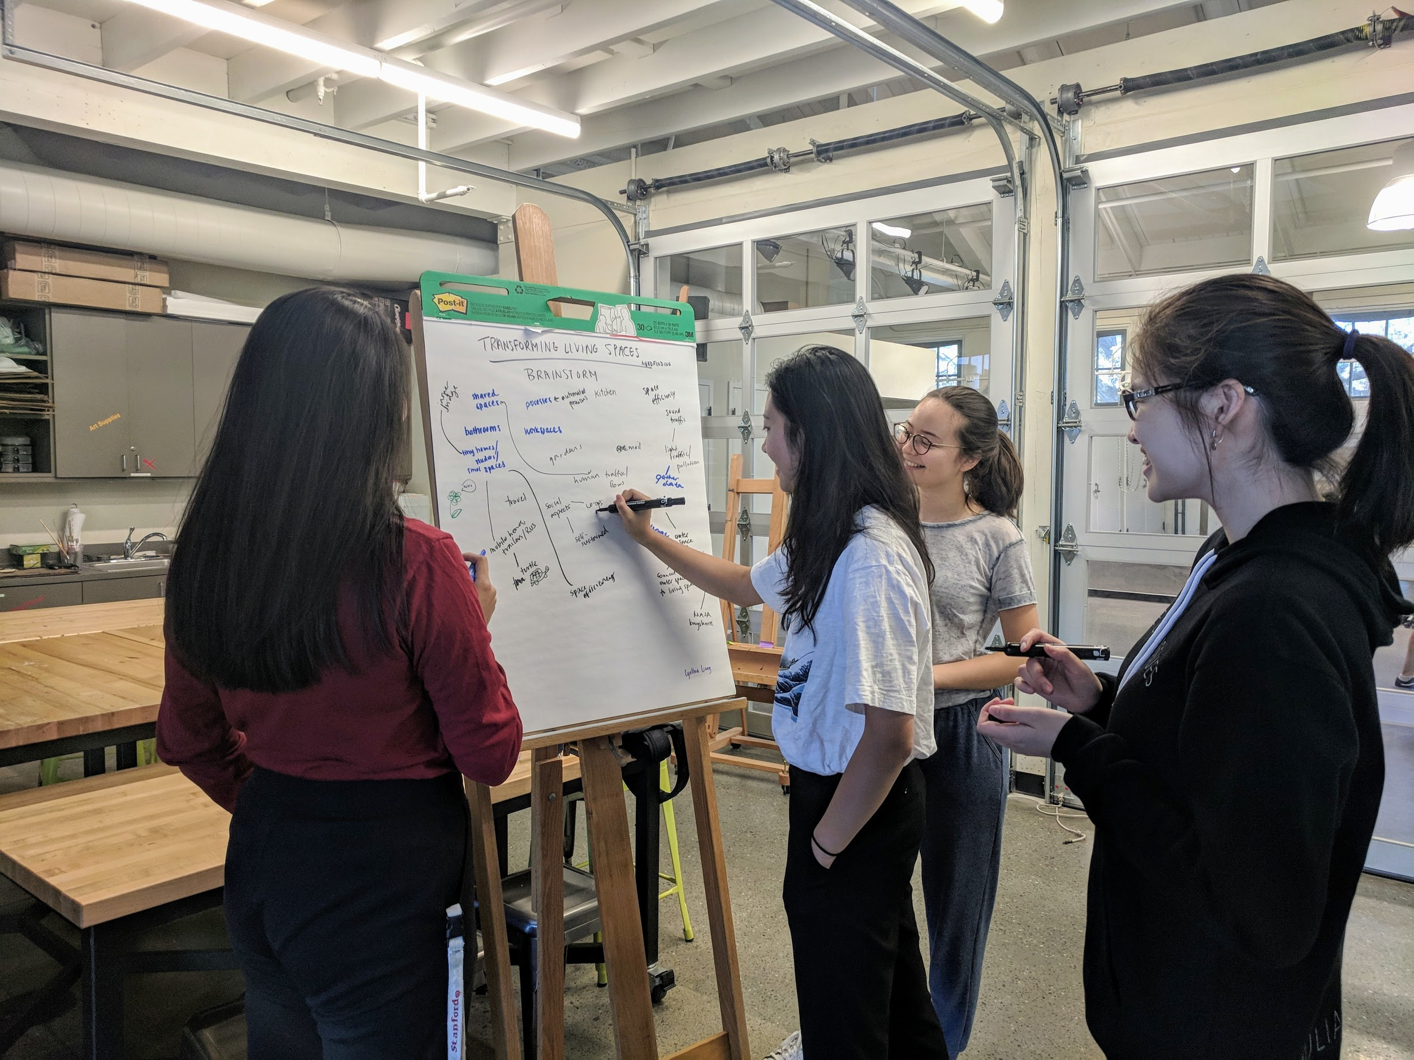
insights

Slide 28
“I cleared out everything, sold stuff I never used, and used the space to relax.”
Enjoys structure & dedicated, purposeful spaces
is concerned about how they look in the photograph
Gets excited when talking about self-designed home refurbishments
Public place & personal place are separate, didn’t touch others’ objects and asked not to be photographed

Slide 29
INSIGHT
NEED
People like to feel like they have personal control over their belongings
A way to exercise purposeful agency on their objects

Slide 30
“What’s bad is that we get used to not fully unpacking.”
Needs organization and personal control in home
“I think [lack of responsibility from dormmates] showed who had been involved in household duties.”

Slide 31
INSIGHT
NEED
People don’t like losing track of/disorganization with what they have
To categorize and manage belongings

Slide 32
Washes dishes and moves around kitchen purposefully cleaning up from a dorm lunch
“[I hold] mostly small gatherings in the home, but inviting people is troublesome.”
Asks to keep interview short
Carefully packs photography bag while talking to us
eats while talking
Positive about proximity and convenience

Slide 33
INSIGHT
NEED
People value their time
Make their goals as easy and low-commitment as possible, while still being effective

Slide 34
“I always try to plant something. I was always crazy about that place that my mother-in-law and grandmother had.”
It’s valuable to take care of items that are personal
“That belonged to my grandmother. That’s what she used to do laundry in. I cleaned it up a bit.”
Very carefully packs photography bag while talking to us

Slide 35
INSIGHT
NEED
People keep or create things that have associations to past or passed experience
To retain and share stories
Notes:
Road trip, cultural heritage, etc

Slide 36
“I think a sense of what home is is the people.”
Values space to invite friends and family
Objects are not that important; people make community
“When we moved back here, [husband] went back to the storage room, pulled out the sofa, and gave it to [member of community].”
Less lonely because he moved to a place with more friends (and a girlfriend)
“I think I just really like how we're comfortable enough to just like spend most of our time at home in the living room either watching TV or talking or vegetating.”
“Nobody paid attention to whether I was there or not . . . I don’t think I felt a strong sense of community in my residence.”
Home is to be shared

Slide 37
“I think a sense of what home is is the people.”
Objects are not that important; people make community
Values space to invite friends and family
“When we moved back here, [husband] went back to the storage room, pulled out the sofa, and gave it to [member of community].”
Less lonely because he moved to a place with more friends (and a girlfriend)
“I think I just really like how we're comfortable enough to just like spend most of our time at home in the living room either watching TV or talking or vegetating.”
VERY IMPORTANT!
“Nobody paid attention to whether I was there or not . . . I don’t think I felt a strong sense of community in my residence.”
Home is to be shared

Slide 38
INSIGHT
NEED
People value community and their friends/family
To build, preserve, remember, and emphasize community, whether or not certain objects are physically present
Notes:
Road trip, cultural heritage, etc

Slide 39
overview
i. needfinding methodology
ii. interview results
iii. analysis
iv. insights
v. summary
vi. questions

Slide 40
summary: people need...
A way to exercise purposeful agency on their objects
To categorize and manage belongings
Make their goals as easy and low-commitment as possible, while still being effective
To retain and share stories
To build, preserve, remember, and emphasize community, whether or not certain objects are physically present

Slide 41
questions?

